Slide 1

System-Wide Impact of Direct Air Capture Integrated with Thermal Energy Storage
Plant Level and Electricity System Impacts
Vinay Konuruª, Aniruddh Mohan^{b} , Hongxi Luo^{b}, Jesse Jenkins^{c}
Undergraduate Senior, Electrical and Computer Engineering; Zero-carbon Energy Systems Research and Optimization Laboratory (ZERO Lab), Andlinger Center for Energy and the Environment
Distinguished Postdoctoral Fellow, Zero-carbon Energy Systems Research and Optimization Laboratory (ZERO Lab), Andlinger Center for Energy and the Environment
Assistant Professor, Department of Mechanical and Aerospace Engineering; Zero-carbon Energy Systems Research and Optimization Laboratory (ZERO Lab), Andlinger Center for Energy and the Environment
Date

Slide 2




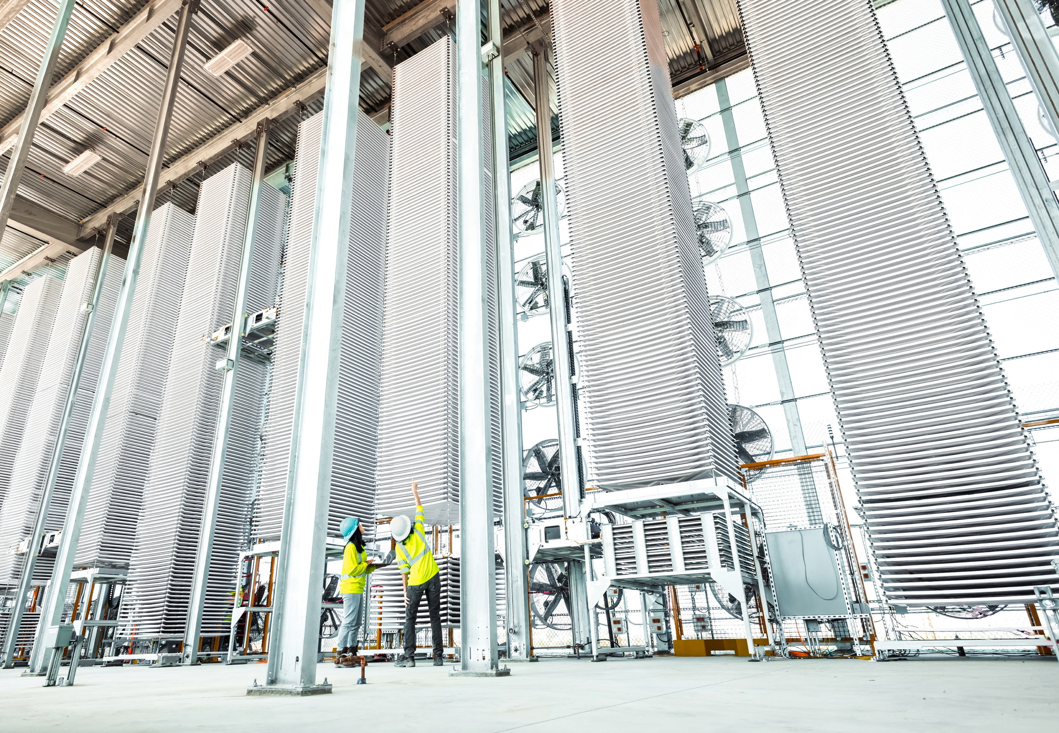
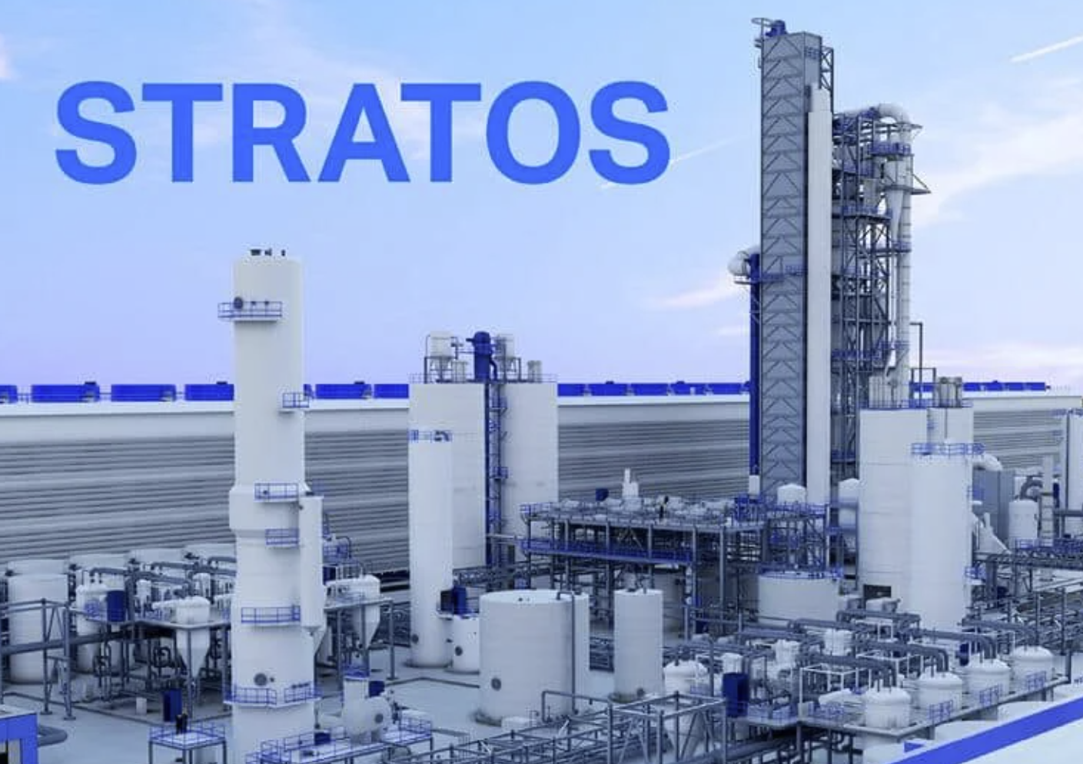
Introduction & Motivations
?
Notes:
In recent years, direct air carbon capture has been gaining significant attention from industry and policy makers as a potential contributor to decarbonizing hard to abate industries. This has resulted in DAC companies developing varied technologies to serve this demand. The end goal of all of this is to reduce energy sector-wide emissions. This makes it critically important to not just understand the plant level costs of CO2 capture, but also the system level emissions reductions when using different DAC implementations.

Slide 3


Introduction & Motivations
Gas + Grid
DAC
Renewables
Notes:
Regardless of the specific technology we employ, one of the biggest challenges of DAC is its inflexibility. As a very high capital cost asset, DAC plants often need to operate continuously to meet capture goals economically. This often means that plants need to operate using firm resources such as gas and grid electricity and can’t take full advantage of intermittent renewables. This increases the operational emissions of the plant and system-wide emissions impact.

Slide 4
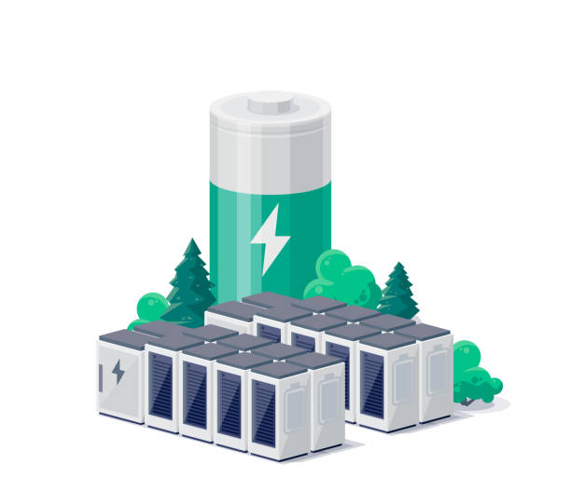

Introduction & Motivations
TES
DAC
Renewables
Notes:
In our research, we wanted to explore the potential for using thermal energy storage to improve the flexibility of how DAC procures heat, allowing it to charge when power prices are low and renewables are abundant and discharge steadily to allow continuous DAC operation. We investigated how the operational emissions, costs, and system-wide impact of various DAC configurations changed when collocated with thermal energy storage.

Slide 5
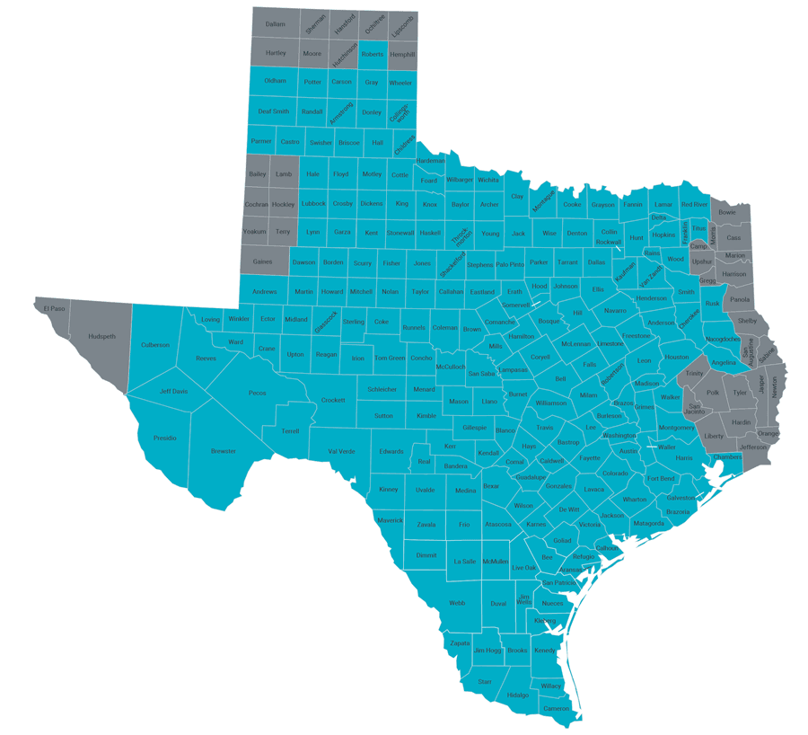
Setup
Plant
Solid sorbent
Grid connected
1MTCO2 Annual Capacity
System
ERCOT
2-Zone System
DAC in East Texas
Notes:
To design our simulations, we made a few decisions about both our plant and the overarching electricity system. The DAC plant is a solid sorbent system, which has low heat requirements typically around 100C for sorbent regeneration. It is also directly connected to the grid in the baseline case for both its heat and power needs, rather than being collocated with a gas plant, allowing us to more easily see its impact on market behavior and sector wide emissions.
We also decided to focus our study within the ERCOT electricity system. Because it is removed from other interconnections, we can more prominently see the impact of different DAC configurations of the system’s emissions. We also decided to represent the system in 2-zones split up into East and West Texas to represent the transmission constraints between rural, highly renewable production West Texas and high-population East Texas. We decided to locate the DAC plant we’re testing in East Texas where there are a large number of potential carbon sequestration sites and where recent plans for a DAC hub were announced.

Slide 6
DAC Plant Configurations
1
DAC + Heat Pump
Parameter | Unit | Value
Total Removals | MtCO₂/yr | 1
DAC Capital Costs per tCO2 (annualized) | $/year | 800
Heat Requirement per tCO2 | MMBTU/ tCO2 | 9.8
Power Requirement per tCO2 | MWh/tCO2 | 0.5
2
DAC + TES
3
DAC + TES + Heat Pump
4
DAC + TES + Turbine
Notes:
We decided to test four different configurations of DAC plants for sourcing heat and power to measure their relative impact on energy sector emissions and plant level costs of capture.

Slide 7
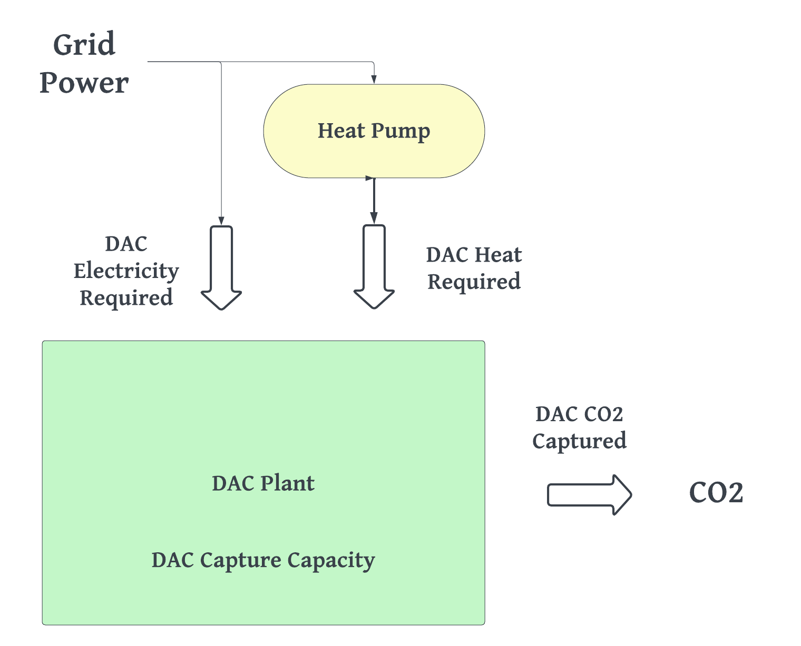
DAC Plant Configurations
1
DAC + Heat Pump
Plant
Solid sorbent
Grid connected
East Texas
Notes:
Our baseline configuration was a DAC + heat pump system where the heat requirements of the DAC plant are supplied from a heat pump with a COP of 2. This setup has little flexibility to use intermittent renewables and no protection from high power prices besides entirely shutting off the DAC plant.

Slide 8
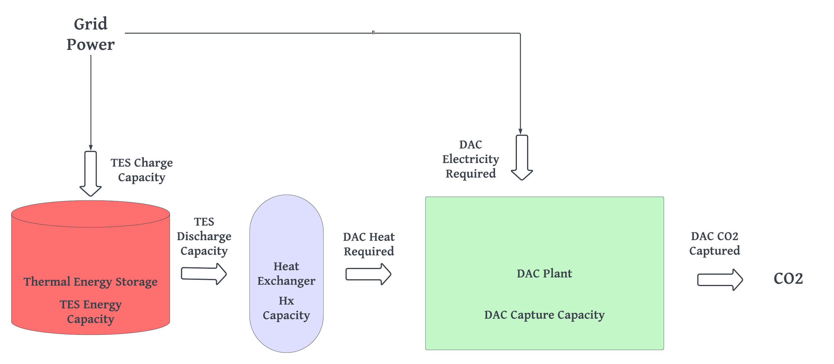
DAC Plant Configurations
2
DAC + TES
Plant
Solid sorbent
Grid connected
East Texas
Notes:
The DAC + TES system allows for the TES to charge using grid electricity and discharge heat to the DAC., allowing for more flexibility in terms of when the DAC plant draws power from the grid for heat.

Slide 9
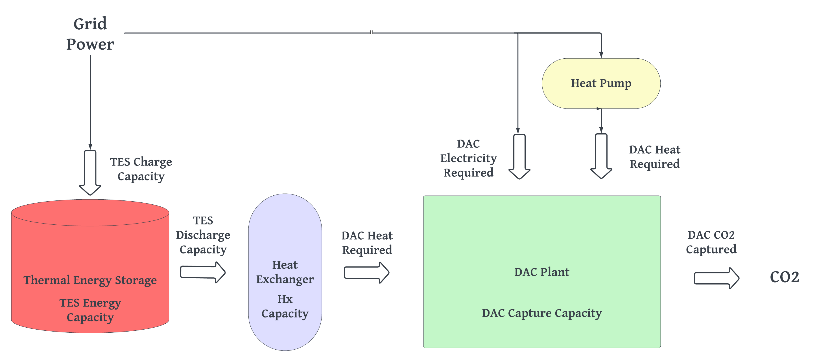
DAC Plant Configurations
3
DAC + TES + Heat Pump
Plant
Solid sorbent
Grid connected
East Texas
Notes:
The DAC + TES + Heat pump merges the benefits of the previous two systems to get a lowest cost combination.

Slide 10
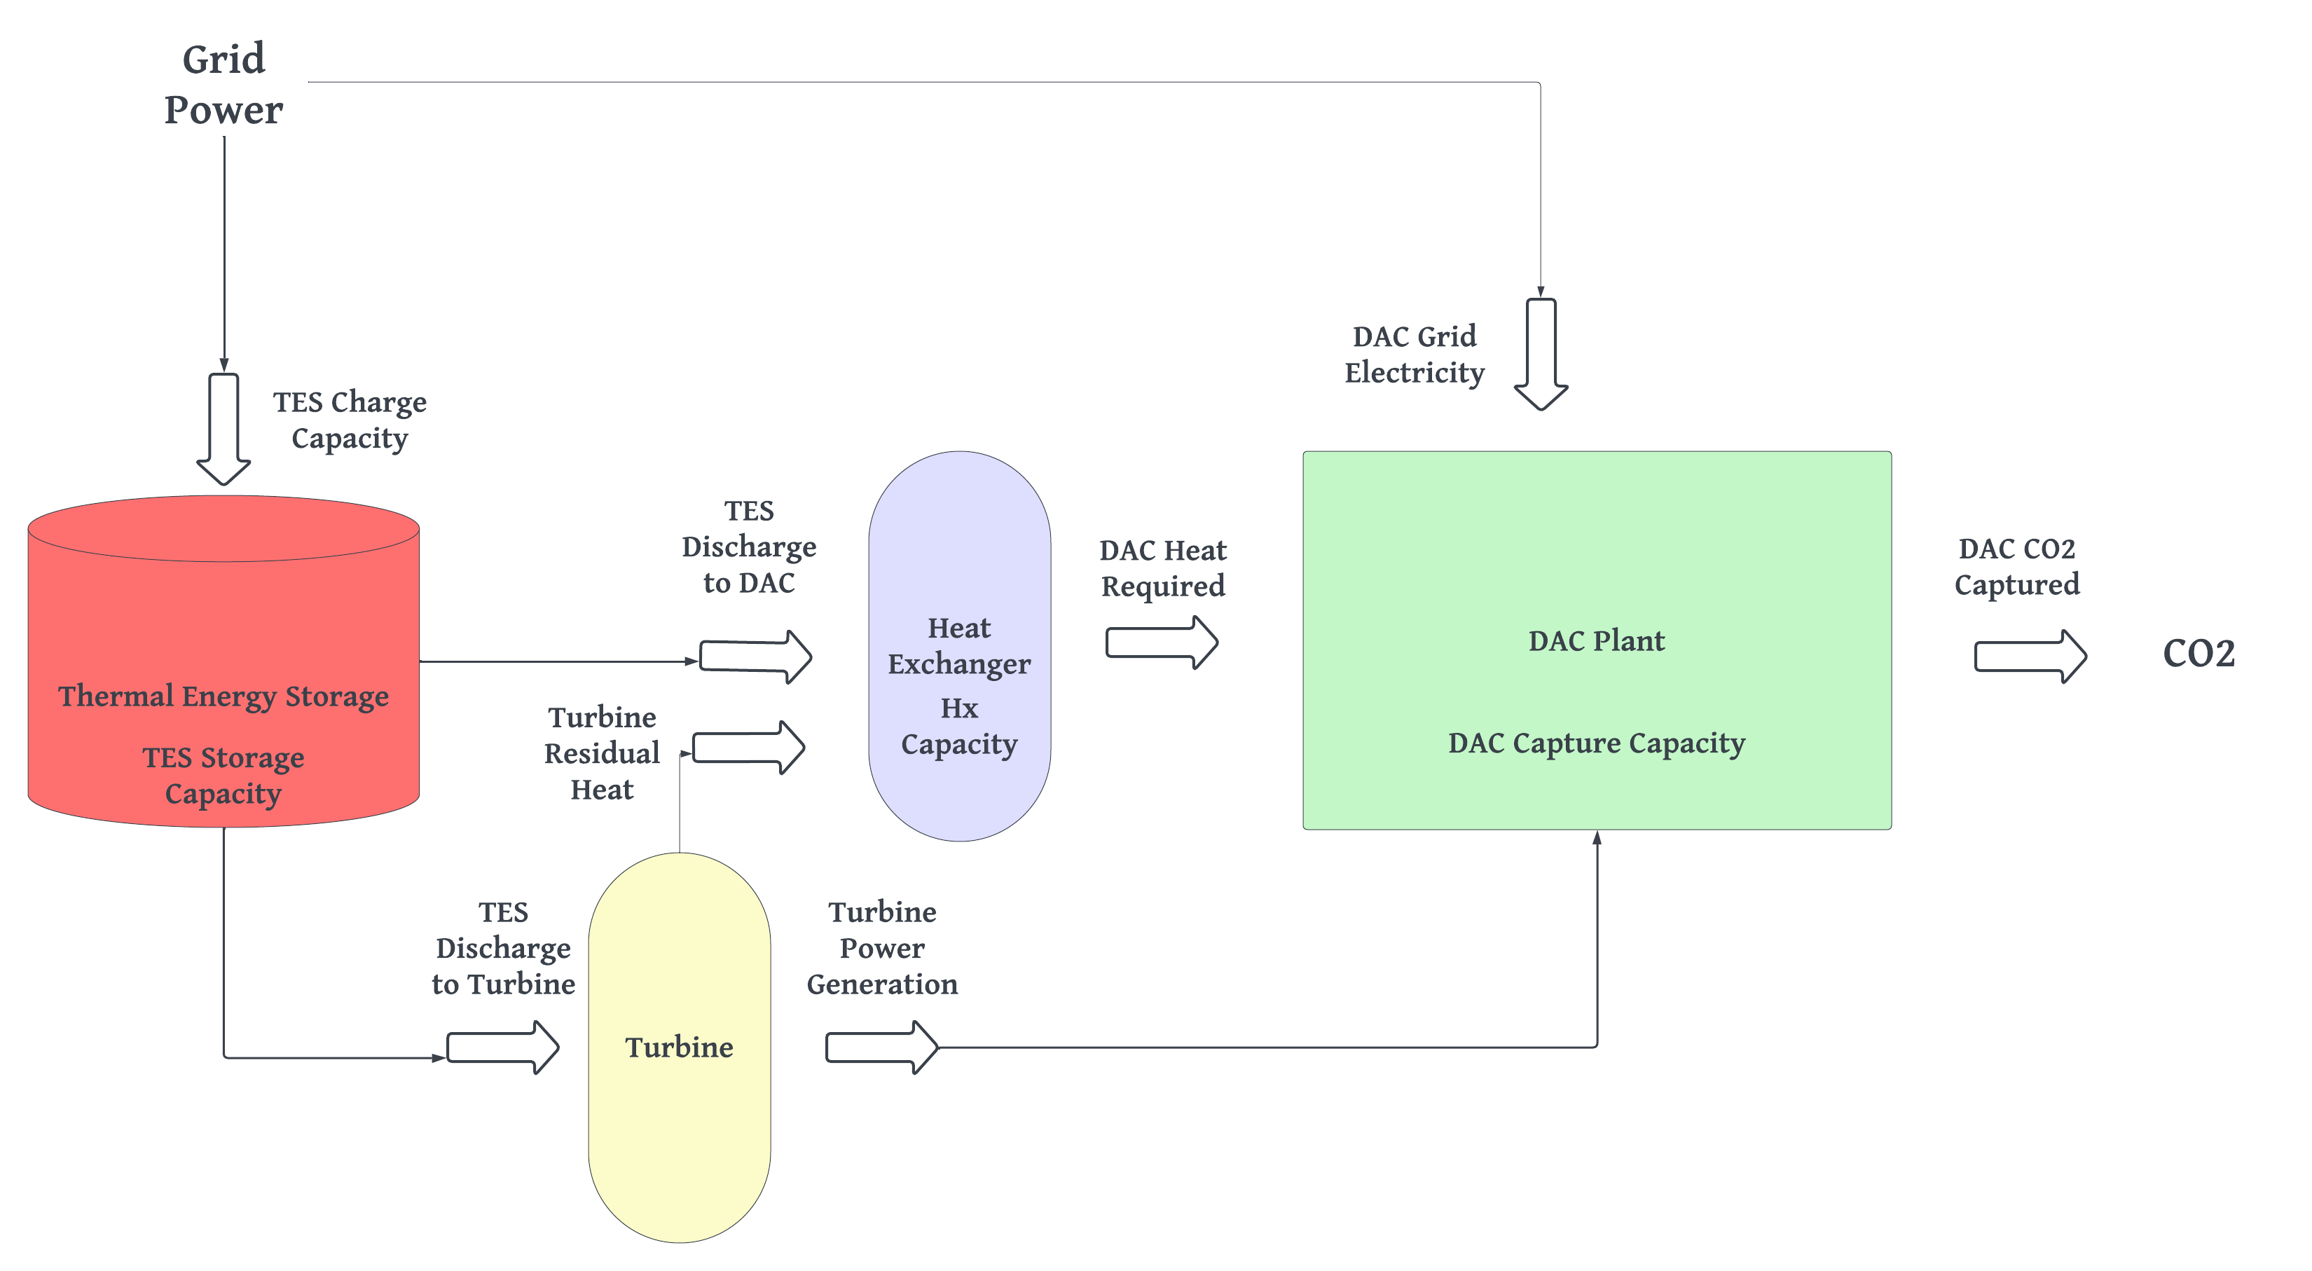
DAC Plant Configurations
4
DAC + TES + Turbine
Plant
Solid sorbent
Grid connected
East Texas
Notes:
The DAC + TES + Turbine fits a steam turbine alongside the TES system, allowing the TES to produce both heat and power for the DAC by discharging some portion of its heat into the turbine.

Slide 11
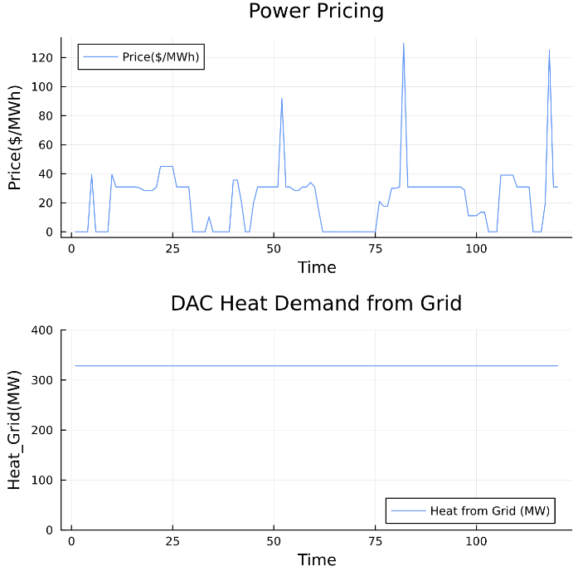
DAC + Heat Pump Operation
Notes:
For intuition, here we show how the DAC plants draws power from the grid to generate heat. Regardless of spikes in power prices, the DAC plant draws steady power because the cost of reducing plant operations and increasing plant capacity to compensate later on is too high. Instead, the plant simply eats these high operational costs throughout the year.

Slide 12
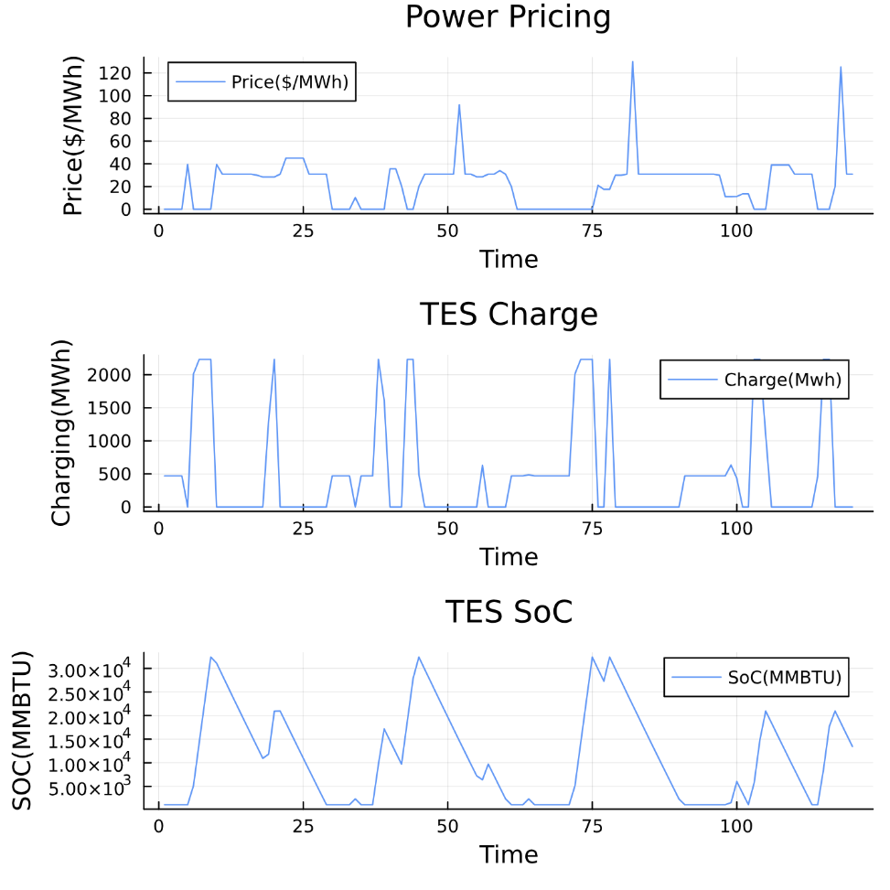
DAC + TES Operation
Notes:
Alternatively, with a DAC + TES system, the DAC plant is able to operate flexibly. Here, we show how the TES system charges during periods when power prices are low, and discharges when they are empty. The sharp peaks you see are possible because of the investment into charge capacity where the TES system is typically sized by our model as a four-hour duration battery.

Slide 13
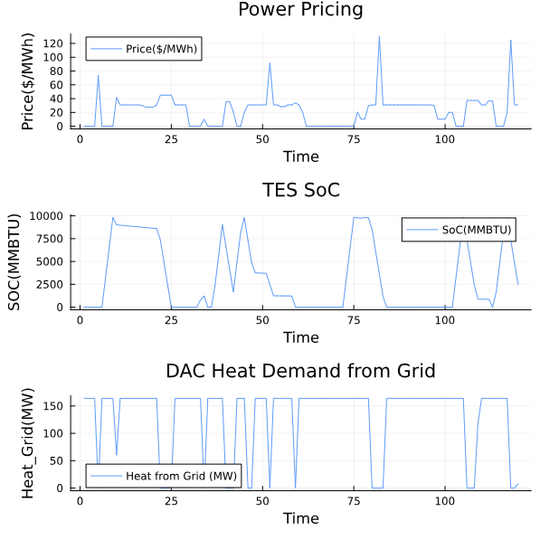
DAC + TES + Heat Pump Operation
Notes:
In the DAC + TES + Heat Pump case, the DAC plant now sizes a much smaller TES system to reduce the fixed costs of this investment, and only uses its limited heat storage capacity as a hedge against short periods of high-power prices. During the remainder of the year, it uses grid electricity. This results in both lower fixed costs than the TES only system, and lower operational costs than the heat pump only system.

Slide 14
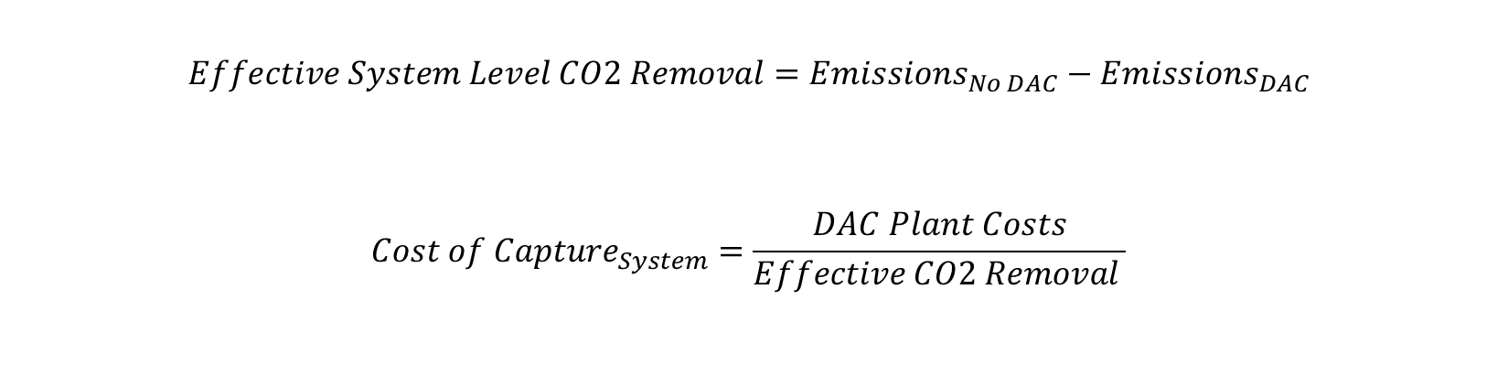
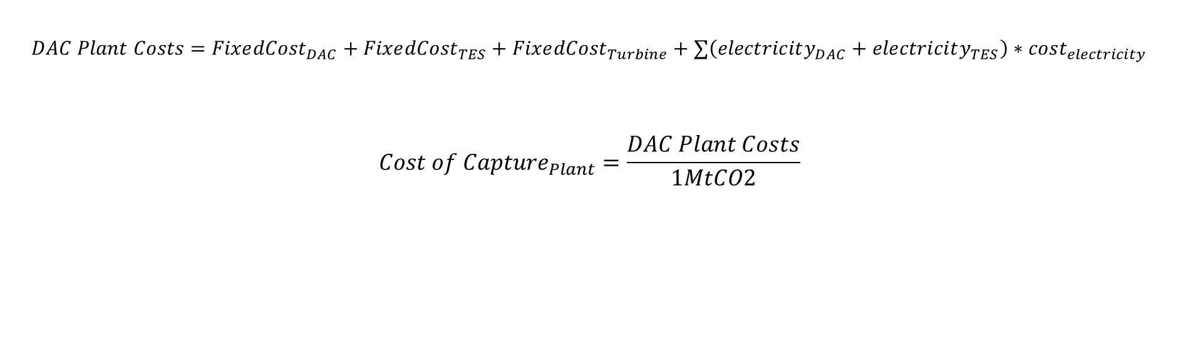
System-Wide vs Plant Level Emissions Reduction Calculations
Plant Level:
$$DAC Plant Costs=Fixe{dCost}_{DAC}+Fixe{dCost}_{TES}+Fixe{dCost}_{Turbine}+∑\left(electricity_{DAC}+electricity_{TES}\right)∗cost_{electricity}$$
$$Cost of Capture_{Plant}=\frac{DAC Plant Costs}{1MtCO2}$$
System Level:
$$Effective System Level CO2 Removal=Emissions_{No DAC}−Emissions_{DAC}$$
$$Cost of Capture_{System}=\frac{DAC Plant Costs}{Effective CO2 Removal }$$
Notes:
To compare plant level versus system level emissions reductions and costs, we needed to define what plant and system level referred to. At the plant level, we define total DAC plant costs as the sum of the fixed and operational costs of any of its equipment. We then define the cost of capture as these costs overall the annual capture capacity of the plant which is 1MtCO2.
At the system level, we calculate our effective (or net) CO2 removals as the difference between the total emissions in an electricity system without any DAC capacity versus one with DAC capacity. In this case, the system level cost of capture is the total DAC plant costs divided by this effective CO2 removal.

Slide 15
Key finding 1: Plant level cost of capture with TES is $50/tCO2 higher
From a plant cost of capture perspective, TES configurations are significantly outcompeted by heat pump configurations due to high fixed costs.
Figure 1: TES and turbine fixed costs each increase the plant level cost of capture by about $50/tCO2. Additionally, because the TES has a lower efficiency in generating heat than the heat pump, the cost of heat produced by the TES system is also more expensive.
Notes:
Plant perspective!
High fixed costs for TES
Despite higher power prices for grid HP, the higher efficiency of the heat pump also results in lower operational costs compared to TES

Slide 16
This trend was driven by the type of power that the TES and heat pump systems were drawing from the grid. TES systems often drew power when renewables were abundant, resulting in significantly lowering operational emissions.
Key finding 2 (Part 1): System level cost of CO2 capture is reduced by $300/tCO2 with TES
Figure 2: CO2 removal costs increased at the system level when procuring heat via a heat pump because of the associated operational emissions. In plants using TES, the system level removal costs decreased due to extra emissions reductions beyond the plant’s operation.
Notes:
Interestingly, we also see that TES configurations had lower costs on the system level than at the plant level. This is only possible if the total renewable generation across the electricity system increased based on the power demand from the DAC. This is exactly what we end up seeing.

Slide 17
Key finding 2 (Part 2): TES plants reduce system-wide emissions beyond DAC capture capacity
Power demand from the TES aligns with periods when renewables are most abundant, resulting in extra buildout of renewable power. This lowers the system level cost of capture in configurations with TES.
1MT
Figure 3: The power demand from TES aligns with periods when power prices are lowest, which is also when renewables are most abundant. This results in extra renewable development, driving down total system emissions beyond the 1MtCO2 capture capacity of the DAC plant.
Notes:
DAC systems with TES decreased system-wide emissions by between 30-50% more than their rated capacity. By drawing power when renewables were super cheap, the TES system created demand for more new build renewable generation.

Slide 18
Total new build generation doubled in scenarios with DAC + TES relative to heat pump configurations with nearly all extra new-build power coming from renewable sources.
Key finding 2 (Part 3): New build renewable generation increases in scenarios with DAC + TES
DAC/TES Energy Requirement
DAC/HP Energy Requirement
Figure 3: New build generation increased by 127% in TES configurations relative to heat pump systems. 58% of the total new-build power in the TES case came from renewable generation, while only 37% came from renewable sources in the heat pump case. This reveals why the TES case experienced a negative emissions penalty.

Slide 19
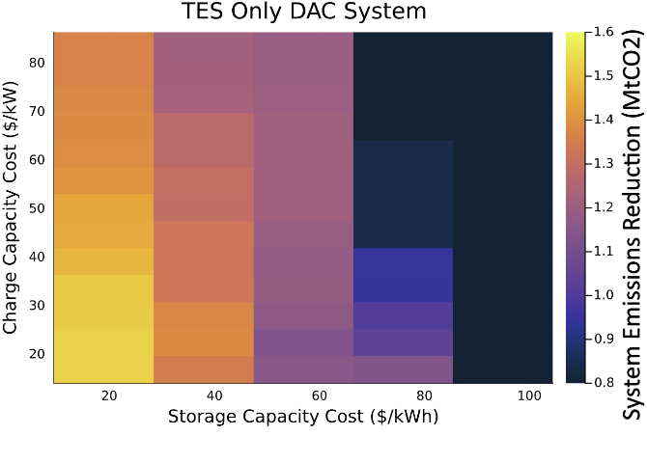
Key finding 3: System emissions reductions are driven by reductions in TES capacity cost
Emissions reductions don’t significantly increase until TES storage costs decrease below $80/kWh. After this, reductions in charge costs also play a role.
Figure 4: DAC + TES configurations have greater system-level CO2 reductions when storage capacity costs decrease. Charge capacity costs do not have a major impact until storage costs are sufficiently low as seen at $80/kWh.

Slide 20

Discussion
Plant vs System Level Emissions Impact
Impact of Cost Reductions
Optimal DAC Locations
Notes:
1. How do we motivate the development of private plants that are maximally beneficial to the energy system?
2. How are the experience curves and cost reductions of these two technologies influenced by collocation?
3. Do the regions where DAC is optimal change based on how it draws heat from the grid?

Slide 21
Future Work
DAC Hubs: Implement several DAC plants within the same zone and in different zones to study how the system level impacts of DAC changes
Renewable Matching: Add constraints requiring DAC plants to only use new-build renewable resources
Location: Simulate DAC plants in other energy systems outside Texas to explore how costs change
Higher Capture Capacity: Model 10MT DAC Plant to see how system dynamics change with larger energy requirements

Slide 22
Appendix
22

Slide 23
TES Cost Data (Part 1)
Storage Capacity Components | Cost ($/kWh) | Charge Capacity Components | Cost ($/kW)
Thermal Storage Medium | 10.3 | Resistance heater wire | 14
Insulation | 0.4 | Transformer | 4
 |  | Grid connection | 4.4

Slide 24
DAC System Characteristics
Parameter | Unit | Value
Total Removals | MtCO₂/yr | 1
DAC Capital Costs per tCO2 (annualized) | $/year | 800
Heat Requirement per tCO2 | MMBTU/tCO2 | 9.8
Power Requirement per tCO2 | MWh/tCO2 | 0.5
Maximum Capacity Factor | - | 95%

Slide 25
TES Cost Data (Part 2)
First of a Kind COST ESTIMATE | Cost Storage ($/kWh) | Cost Charge ($/kW)
Purchased Equipment Cost | 11 | 22
including Bare Erect Cost adder (bare erect cost, includes balance of system costs) | 16 | 34
including EPC adder (engineering, management, construction) | 19 | 40
including contingency adder (unknown costs) at 90% of BEC | 34 | 71

Slide 26
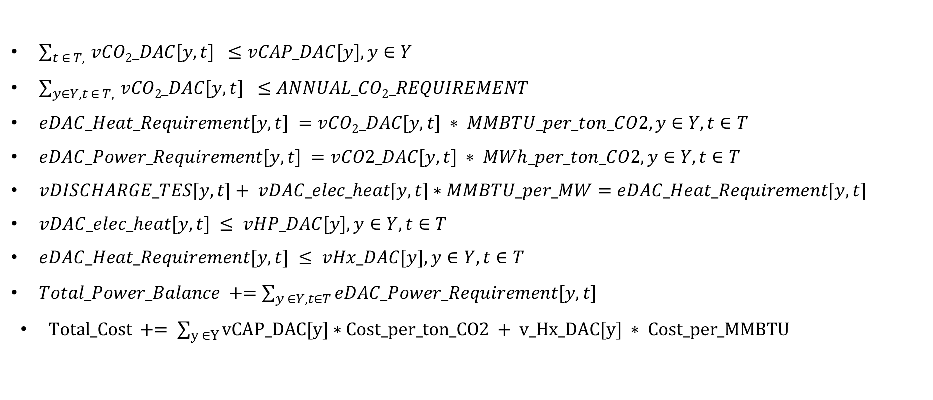
DAC Problem Formulation
$\sum_{t ∈ T, }{vCO2_DAC[y, t] } ≤vCAP_DAC[y], y∈Y$
$\sum_{y∈Y, t ∈ T, }{vCO2_DAC[y, t] } ≤ANNUAL_CO2_REQUIREMENT$
$eDAC_Heat_Requirement[y,t] =vCO2_DAC[y,t] ∗ MMBTU_per_ton_CO2, y∈Y, t∈T$
$eDAC_Power_Requirement[y,t] =vCO2_DAC[y,t] ∗ MWh_per_ton_CO2, y∈Y, t∈T$
$vDISCHARGE_TES[y,t]+ vDAC_elec_heat[y,t]∗MMBTU_per_MW=eDAC_Heat_Requirement[y,t]$
$vDAC_elec_heat[y,t] ≤ vHP_DAC[y], y∈Y, t∈T$
$eDAC_Heat_Requirement[y,t] ≤ vHx_DAC[y], y∈Y, t∈T$
$Total_Power_Balance +=\sum_{y ∈Y, t∈T}{eDAC_Power_Requirement[y, t] }$
$Total_Cost += \sum_{y ∈Y}{vCAP_DAC[y]∗Cost_per_ton_CO2 + v_Hx_DAC[y] ∗ Cost_per_MMBTU }$

Slide 27
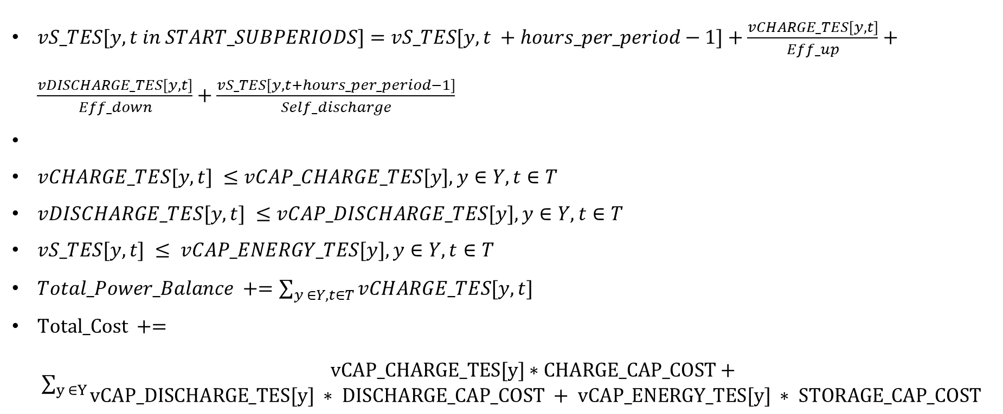
TES Problem Formulation
$vS_TES[y,t in START_SUBPERIODS]=vS_TES[y,t +hours_per_period−1]+\frac{vCHARGE_TES[y,t]}{Eff_up}+\frac{vDISCHARGE_TES[y,t]}{Eff_down}+\frac{vS_TES[y,t+hours_per_period−1]}{Self_discharge}$
$vCHARGE_TES[y, t] ≤vCAP_CHARGE_TES[y], y∈Y, t∈T$
$vDISCHARGE_TES[y, t] ≤vCAP_DISCHARGE_TES[y], y∈Y, t∈T$
$vS_TES[y,t] ≤ vCAP_ENERGY_TES[y], y∈Y, t∈T$
$Total_Power_Balance +=\sum_{y ∈Y, t∈T}{vCHARGE_TES[y, t] }$
$Total_Cost += \sum_{y ∈Y}{\begin{aligned}vCAP_CHARGE_TES[y]∗CHARGE_CAP_COST+ \\ vCAP_DISCHARGE_TES[y] ∗ DISCHARGE_CAP_COST + vCAP_ENERGY_TES[y] ∗ STORAGE_CAP_COST\end{aligned}}$

Slide 28
Comparing Configurations
Heat Pump Pros: Low fixed costs High heat generation efficiency Cons: No flexibility | TES Pros: Flexibility in heat production Cons: High fixed costs
Heat Pump + TES Pros: Smaller TES Cons: Lower heat storage capacity | TES + Turbine Pros: Energy security Cons: High fixed costs
Notes:
We wanted to test four different configurations for grid-connected DAC plants to procure heat and power. First, in a

Slide 29
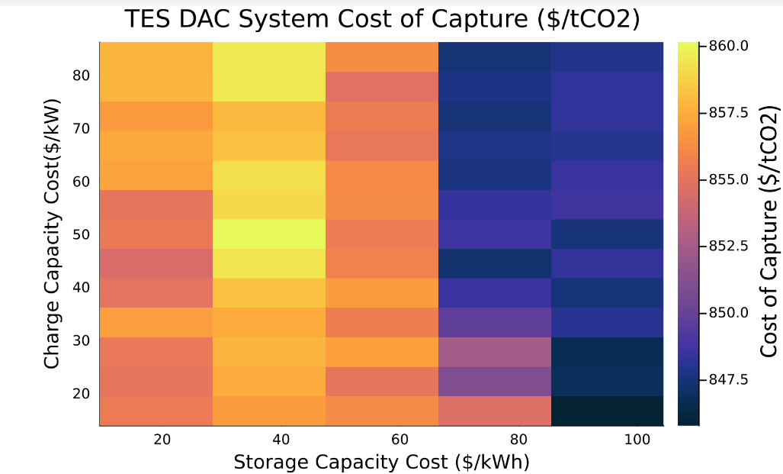
Key finding 4: Plant level costs of DAC + TES systems only decrease by $15/tCO2 as TES costs drop
Plant level cost of capture stays relatively the same between $845-$860/tCO2 across the TES cost space
Figure 5: DAC + TES configurations have similar cost of capture despite reductions in TES cost. If a plant intends to install TES for the system-level benefits, it would likely be beneficial to purchase sooner than later to capture early-adoption 45X Advanced Manufacturing tax credits while they are available.

